Slide 1
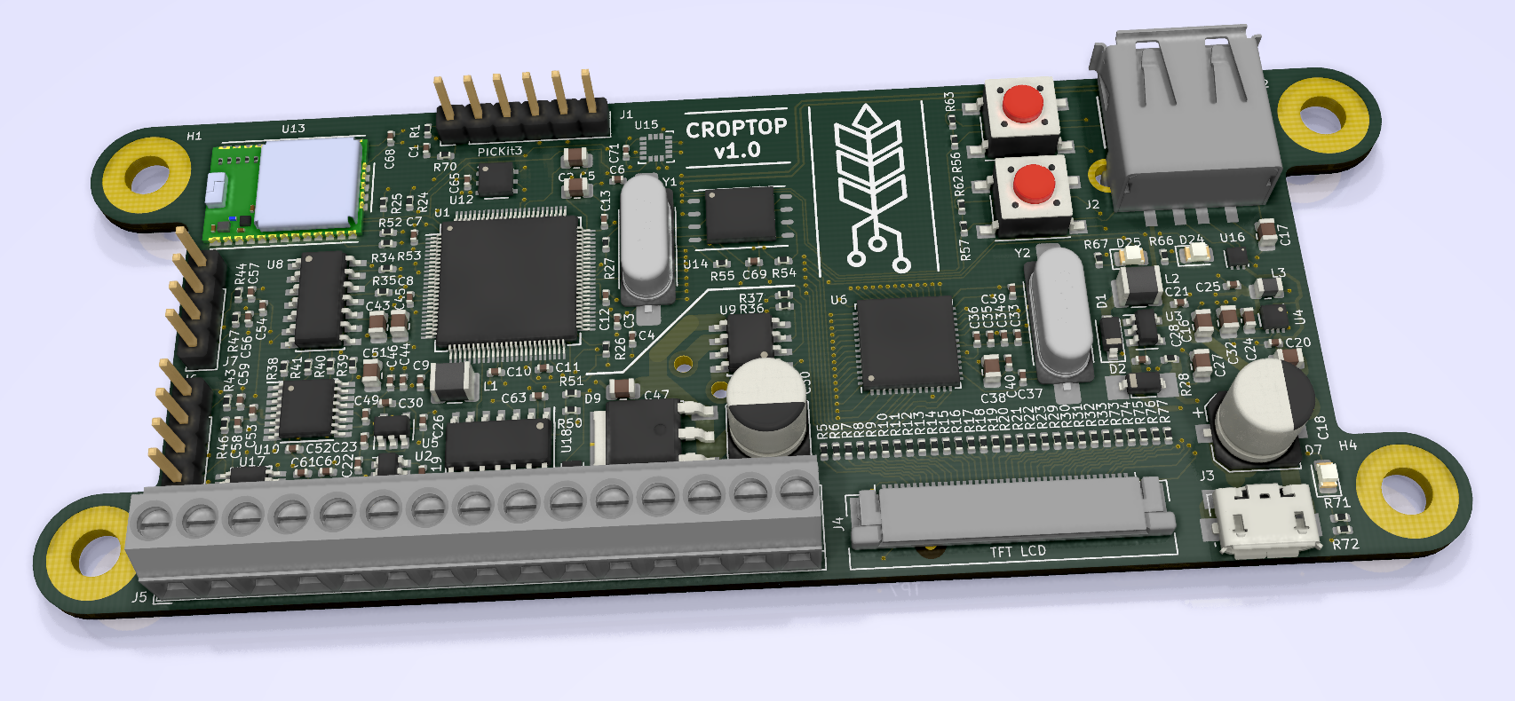
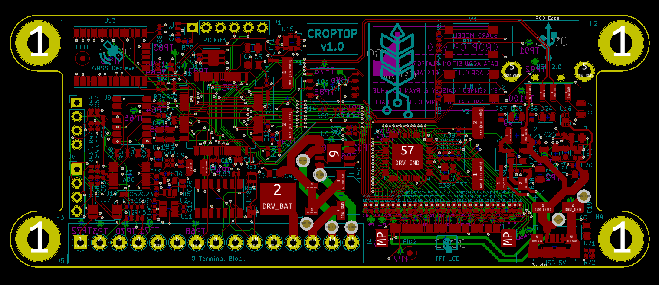
cereal grain Data Acquisition device
Designed by Ryan Donahue & Kennedy Caisley, for Dr. Daniel Robertson
Project SCOPE
Technical specifications
Wind-induced crop failure results in economic losses totaling tens of billions of dollars each year. A data acquisition computing platform has been designed that will enable researchers to understand this issue and breed more resilient crop varieties. The device features custom electronics hardware and embedded firmware, with an emphasis on design for manufacturability and reliability.
24-bit Load Cell Interface X3
USB 2.0 Embedded Host Interface
Supports flash drives & barcode scanner
Rotary/Linear Encoder Interface
Configurable for 3.3V/5V
Ultrasonic Ranging Module Interface
Embedded Temperature and Humidity Sensor
Embedded Accelerometer
Provides tilt/angle of unit
uSD Card Interface
Embedded Graphic Processing Unit
Creates GUI on 800x480 7” TFT LCD
Supports resistive touchscreen
GNSS Receiver w/ Onboard Antenna
Provides time, date, and location data
microUSB Power Port
Onboard stepper motor driver
Onboard DC motor driver
Peripheral Header for Daughter Module
Design outcomes
Requirement | Past Design/Prototype | Current Design
Reduce Assembly Time | 20 hours | 1 hour
Decrease Production Cost | $600 per board | $150 per board
Improve Quality Control and Reliability | Intern solder fun time | Order with one-click through small-batch assembly
Improve Data Acquistion | 10Hz with 16-bit ADC load cell data | 470Hz with 24-bit ADC load cell data
Replace User Interface | Mechanical button input | Resistive touch-screen
Centralize Firmware Development | Rasberry Pi and Arduino based system | PIC32 C based system with Github code repository
Acknowledgements

